Slide 1


Data Science Bootcamp
#1 rated Coding and Data Science Program in all of Orange County, Los Angeles, and the Inland Empire.
Prep Course Introduction - Python

Slide 2


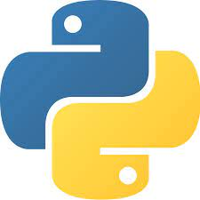
Python Functions
Functions

Slide 3
Python Functions
A function is a reusable block of code which performs specific operations. They help break down tasks into smaller units and allow reuse of code.
Function can be called any number of times

Slide 4
Python Functions
Built in functions
User defined functions
Lambda functions
Recursion functions

Slide 5
Built in functions
print()
sum()
range()
list(), tuple()
input()
max(), min()

Slide 6
Defining functions
Function block begins def followed by the function name and parentheses() and colon:
Input parameters or arguments can be passed or initiated within the parentheses
Body of a function starts after the colon and is indented
The statement return exits a function, passing a value back

Slide 7
Defining functions
Your function name
Parameter
def function_name(username):
print(“Hello ”+username)
function_name(username = ‘Belle’)
function body
Define your function
Always indented
Local variable
Call your function
argument

Slide 8
Rules for naming a Function
Function name can start with A-Z, a-z, and underscore(_).
Function name can include A-Z, a-z, digits(0-9), and underscore(_).
Avoid using keywords as name of the functions
Try making the name of the function relevant

Slide 9
User defined functions
A blocks of code that is written to do one specific job. Allows us to reuse code without rewriting code
def function_name(username):
print(“Hello ”+username)
Notes:
Coding best practice is DRY - Don't repeat yourself

Slide 10
Parameter
The variable username in the definition of the above functions is an example of a parameter, a piece of information the function needs to do its job.

Slide 11
Argument
An argument is a piece of information that is passed from a function call to a function.

Slide 12
User defined functions
def function_name(username):
print(“Hello ”+username)
def function_name_return(username):
return(“Hello ”+username)
Notes:
Coding best practice is DRY - Don't repeat yourself

Slide 13
Variable Scope and Lifetime
A variable isn’t visible everywhere and alive every time.
A variable’s scope tells us where in the program it is visible. A variable may have local or global scope.
A variable’s lifetime is the period of time for which it resides in the memory.

Slide 14
Functions Exercise
Write a function that takes two inputs and adds the two numbers together and returns the result.

Slide 15
User defined functions
def employee_info(*args,**kwargs):
print(args)
print(kwargs)
Notes:
Coding best practice is DRY - Don't repeat yourself

Slide 16
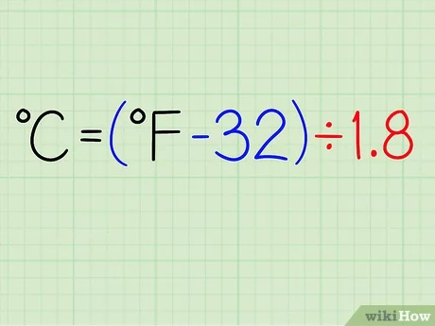
Functions Exercise
Write a function, when provided temperature in fahrenheit convert the value to celsius

Slide 17
Functions Exercise
Write a function, when given an input of month tells us how many days in that month
days_in_month = [31, 28, 31, 30, 31, 30, 31, 31, 30, 31, 30, 31]

Slide 18
Functions Exercise
Given a year, determine whether it is a leap year. If it is a leap year, return the Boolean True, otherwise return False.
In the Gregorian calendar, three conditions are used to identify leap years:
The year can be evenly divided by 4, is a leap year, unless:
If the year can be evenly divided by 100, it is NOT a leap year, unless:
The year is also evenly divisible by 400. Then it is a leap year.

Slide 19
Functions Exercise
# Combines the elements of two lists if they are not equal:
x = [1,2,3]
y = [3,1,4]

Slide 20
Functions Exercise
Exercise:
Create a dictionary using the string below, the dictionary should have the alphabet as key and the index as value.
'abcdefghijklmnopqrstuvwxyz'
{‘a’:0, ‘b’:1 ………….}

Slide 21
Lambda Functions
A lambda function is an anonymous function.
You can use a Lambda in situations where we would need a function that is going to be used only once.

Slide 22
Lambda Functions
Exercise:
Write a function to add "Ms" as title to the following list using a lambda function
l = ["Kim","Dona","Diana","Crystal"]

Slide 23
Classes
A class is written by a programmer in a defined structure to create an object (computer science) in an object-oriented programming language. It defines a set of properties and methods that are common to all objects of one type.
class student:
pass:

Slide 24
Classes and instance
Class is a blueprint for creating instances
Each unique student would be an instance of the class
student _1 = student()
student_2 = student()

Slide 25
Classes and instance
class student:
def __init__(self, first, last):
self.first = first
self.last = last
self.email = first+"."+last+"@lf.com"

Slide 26
Classes
Exercise :
Restaurant: Make a class called Restaurant. The __init__() method for Restaurant should store two attributes: a restaurant_name and a cuisine_type. Make a method called describe_restaurant() that prints these two pieces of information, and a method called open_restaurant() that prints a message indicating that the restaurant is open.
Make an instance called restaurant from your class. Print the two attributes individually, and then call both methods.

Slide 27
Function Exercise
Exercise :
Write a Python function to generate two parallel list of alphabets and their position from 1 to 26.
Write a Python function to generate a dictionary of position of alphabets, alphabet as the key and value as position of the alphabet from 1 to 26.

Slide 28
Python statements
Assignment
print
if/elif/else
for/else
while/else
pass
a, b = 'good', 'bad'
print('Python')
if "python" in text:
print(text)
for x in mylist:
print(x)
while X > Y:
print('hello')
while True:
pass

Slide 29
Python statements
break
continue
def
return
yield
global
while True:
if exittest(): break
while True:
if skiptest(): continue
def f(a, b, c=1, *d):
print(a+b+c+d[0])
def f(a, b, c=1, *d):
return a+b+c+d[0]
def gen(n):
for i in n: yield i*2
def function():
global x

Slide 30
Python statements
import
from
class
try/except
with
del
import sys
from sys import stdin
class Subclass(Superclass):
x = []
def method(self): pass
try:
action()
except:
print('action error')
with open('data') as myfile:
process(myfile)
del variable

